Slide 1
IBM University Engagement Project Submission
“Exploring the Power of Agentic AI with IBM Granite and IBM Bob”

Slide 2

Project Tile – course content simplification agent
Domain of Project – Education
Student Name | Recent Passport Photo | Email ID | Mobile number [WhatsApp]
Sri Chandana Nemalidinne |  | Project done with— chandusri016@gmail.com Registered in aicte with-- srichandana045@gmail.com | 7013897880
Recommended font style and size:
Font Style: Arial
Font Size (Heading): 28
Font Size (Content): 20

Slide 3
Problem Statement -
Problem Statement : Course Content Simplification Agent
The Challenge
Educational materials often vary in complexity and are not always accessible to learners with different levels of prior knowledge. Students may struggle to grasp key concepts due to jargon-heavy or overly advanced explanations in faculty notes and textbooks. The challenge is to develop an AI-powered agent that can intelligently analyze academic content and reframe explanations based on the learner's current proficiency—ranging from beginner to expert. This would support more inclusive learning and personalized education delivery at scale.
The Objective
Build an AI-powered Course Content Simplification Agent that delivers personalized explanations for learners at different proficiency levels. The solution should:
• Content Analysis – Analyze academic content provided by the user.
• Level-Based Simplification – Reframe explanations according to the learner's proficiency level.
• Beginner Level – Explain concepts using simple language and basic examples.
• Intermediate Level – Provide clear explanations with moderate technical detail.
• Advanced Level – Provide deeper explanations with more technical details.
• Expert Level – Provide precise explanations using advanced technical terminology.
• Key Points – Extract and present the most important concepts.
• Important Terms – Identify and explain difficult or technical terms.

Slide 4
Proposed Solution -
Proposed Solution: AI-Powered Course Content Simplification Agent
The proposed solution is an AI-powered Course Content Simplification Agent built using IBM Bob and IBM Granite to provide personalized explanations of academic content based on the learner's proficiency level.
At its core, the solution analyzes faculty notes, textbook content, or other academic material provided by the learner and intelligently reframes the content using simple or advanced explanations according to the selected learning level.
The system supports four learner levels:
Beginner Level provides simple explanations using easy-to-understand language and basic examples.
Intermediate Level provides clear explanations with moderate technical detail.
Advanced Level provides deeper explanations with more technical concepts.
Expert Level provides precise and detailed explanations using advanced technical terminology.
The system consists of the following key functionalities:
Content Analysis analyzes the academic content entered by the user and identifies the important concepts.
Level-Based Simplification adapts the explanation according to the learner's selected proficiency level.
Key Points Extraction identifies and presents the most important points from the provided academic content.
Important Terms identifies difficult or technical terms and provides easy-to-understand explanations.
Example Generation provides relevant examples to help learners understand complex concepts more easily.
The solution includes a user-friendly web interface where learners can enter the subject, select their proficiency level, paste academic content, and receive a personalized simplified explanation.
IBM Bob is used during the development of the project to create, organize, and assist with the application code and project workflow. IBM Granite is used as the AI model for understanding academic content and generating level-appropriate explanations.
Overall, this solution provides an intelligent and personalized learning assistant that helps students understand complex academic materials more easily and supports inclusive education by adapting content from beginner to expert level.

Slide 5
Technology Used
Technologies Used – Course Content Simplification Agent
You can use this directly in your project report/PPT:
Technologies Used
IBM Bob – AI-powered development environment used to build and develop the project.
IBM watsonx.ai – AI/LLM platform used for content understanding and simplification.
Granite LLM – Language model used to summarize and simplify course content.
Prompt Engineering – Designed prompts to convert complex educational content into simple, easy-to-understand language.
Python – Used for application logic, content processing, and AI integration.
Document Processing – Used to extract and process content from course materials such as PDF, DOCX, and TXT files.
Web UI – Interface for students to upload course content and view the simplified output.
IBM Cloud – Cloud environment for hosting and integrating IBM AI services.
API Integration – Used to connect the application with AI/LLM services.
Database/Storage – Used for storing processed content, user information, or generated results where required.

Slide 6
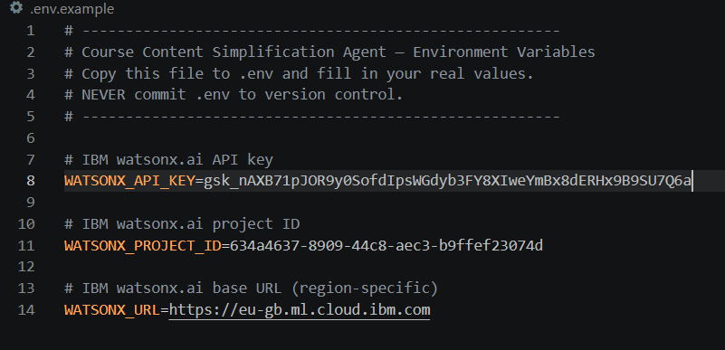
Required Files created using IBM bob -
App.py
Requirements.txt
Style.css
.env
Index.html

Slide 7
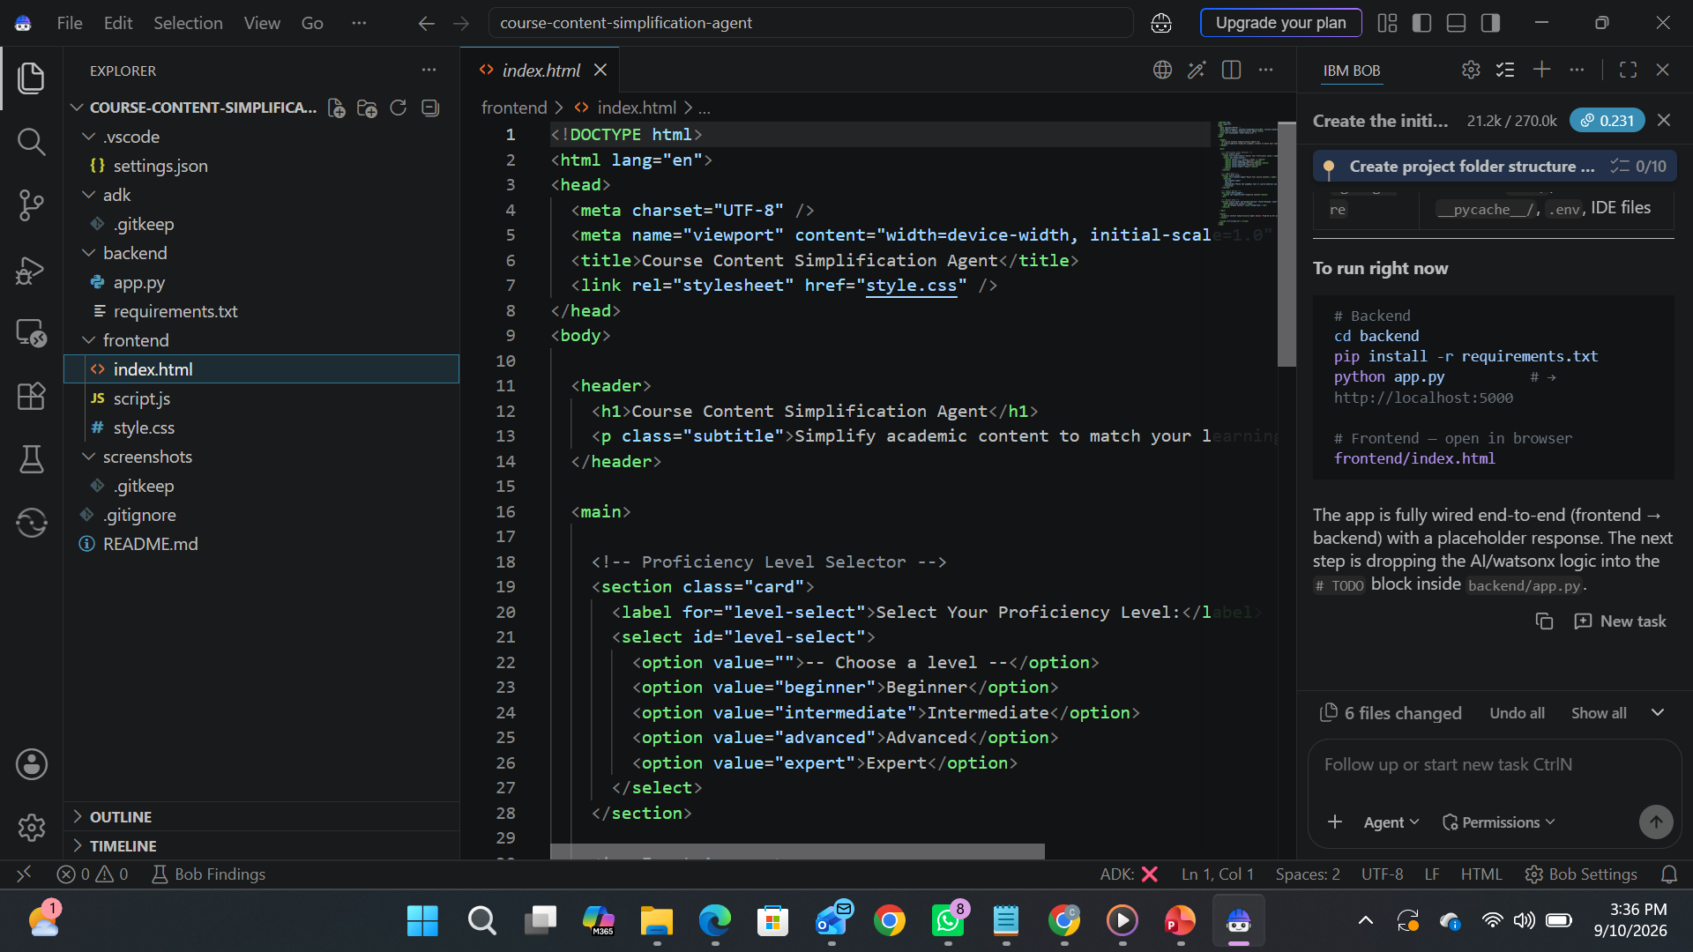
IBM Bob Screenshots:

Slide 8
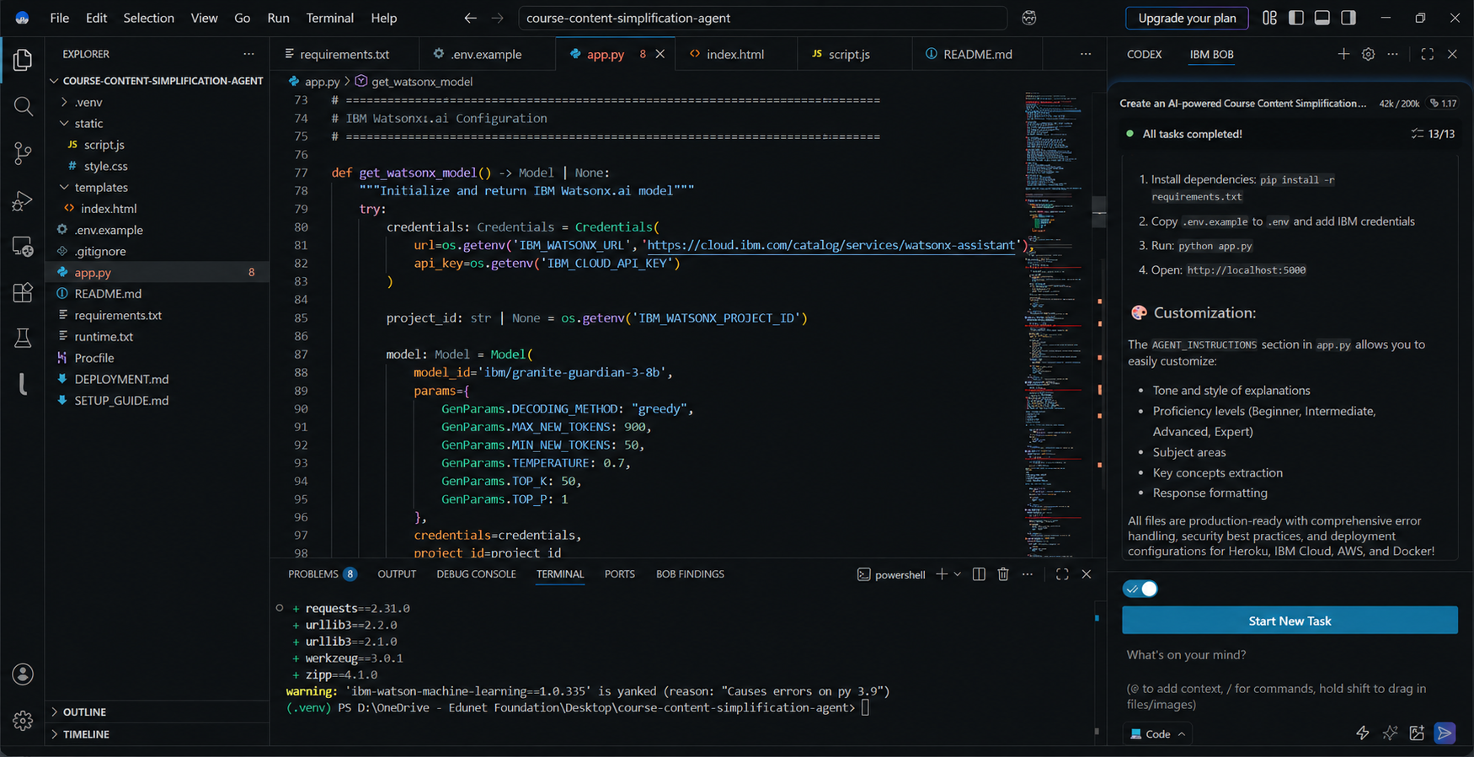

Slide 9
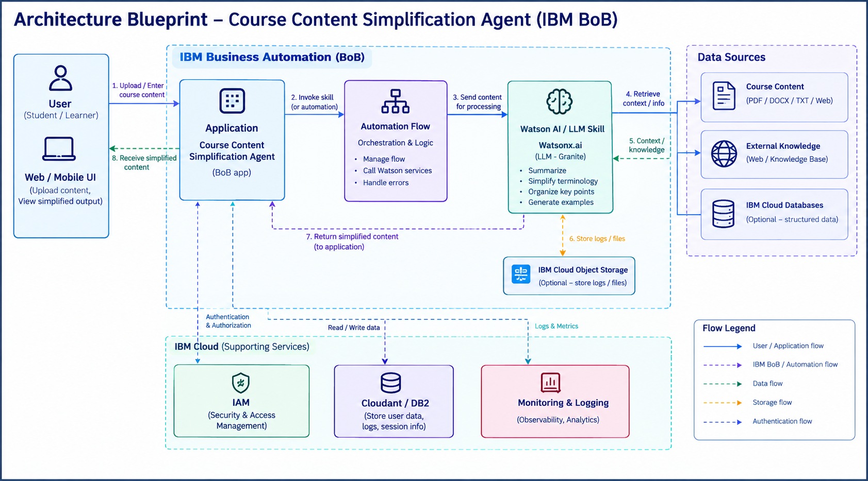
Architecture blueprint for IBM bob:

Slide 10

Role of Agentic AI in the solution
Role of Agentic AI in Course Content Simplification Agent
Agentic AI
Agentic AI enables the Course Content Simplification Agent to function as an intelligent and autonomous learning assistant rather than a simple chatbot. Using IBM watsonx.ai and IBM Granite models, it can coordinate multiple specialized agents to simplify and organize educational content effectively.
Each agent performs a specific role—such as analyzing course material, identifying important concepts, simplifying complex topics, generating summaries, and creating study questions—while working collaboratively. This multi-agent approach helps ensure efficient content processing and produces clear, structured, and easy-to-understand learning material.
Agentic AI also provides context awareness, allowing the system to understand the learner's requirements, course topic, difficulty level, and preferred learning format. Based on this context, it can generate personalized explanations and study materials.
It also supports real-time adaptation, continuously modifying the simplified content based on user feedback and additional questions. The agents communicate with each other to improve content analysis, simplify difficult concepts, and provide more relevant learning support.
Overall, Agentic AI makes the Course Content Simplification Agent intelligent, interactive, personalized, and goal-driven. It acts like a smart digital learning assistant that helps students understand complex course content quickly and effectively.

Slide 11
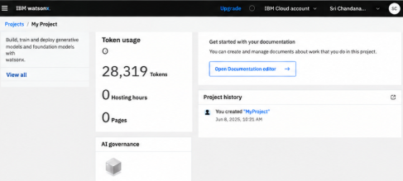
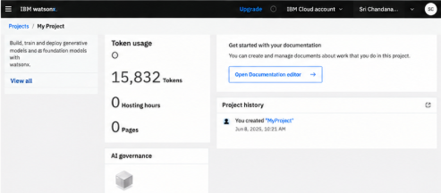
Token Usage
28,319 token are used
Before Prompt
After the Prompt
·
·

Slide 12
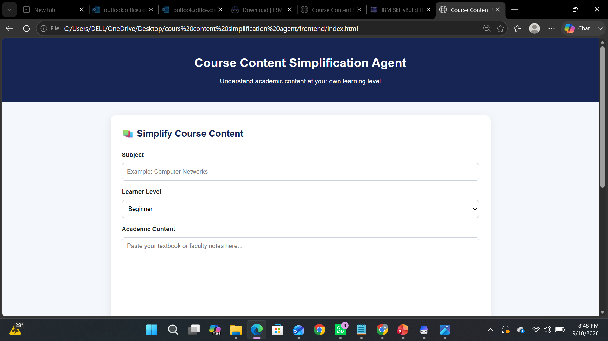
Project Output Screenshot
Please put IBM Bob output screenshots with 2-3 prompts.
You can take 2-3 more slides for each screenshot
·
·
·

Slide 13
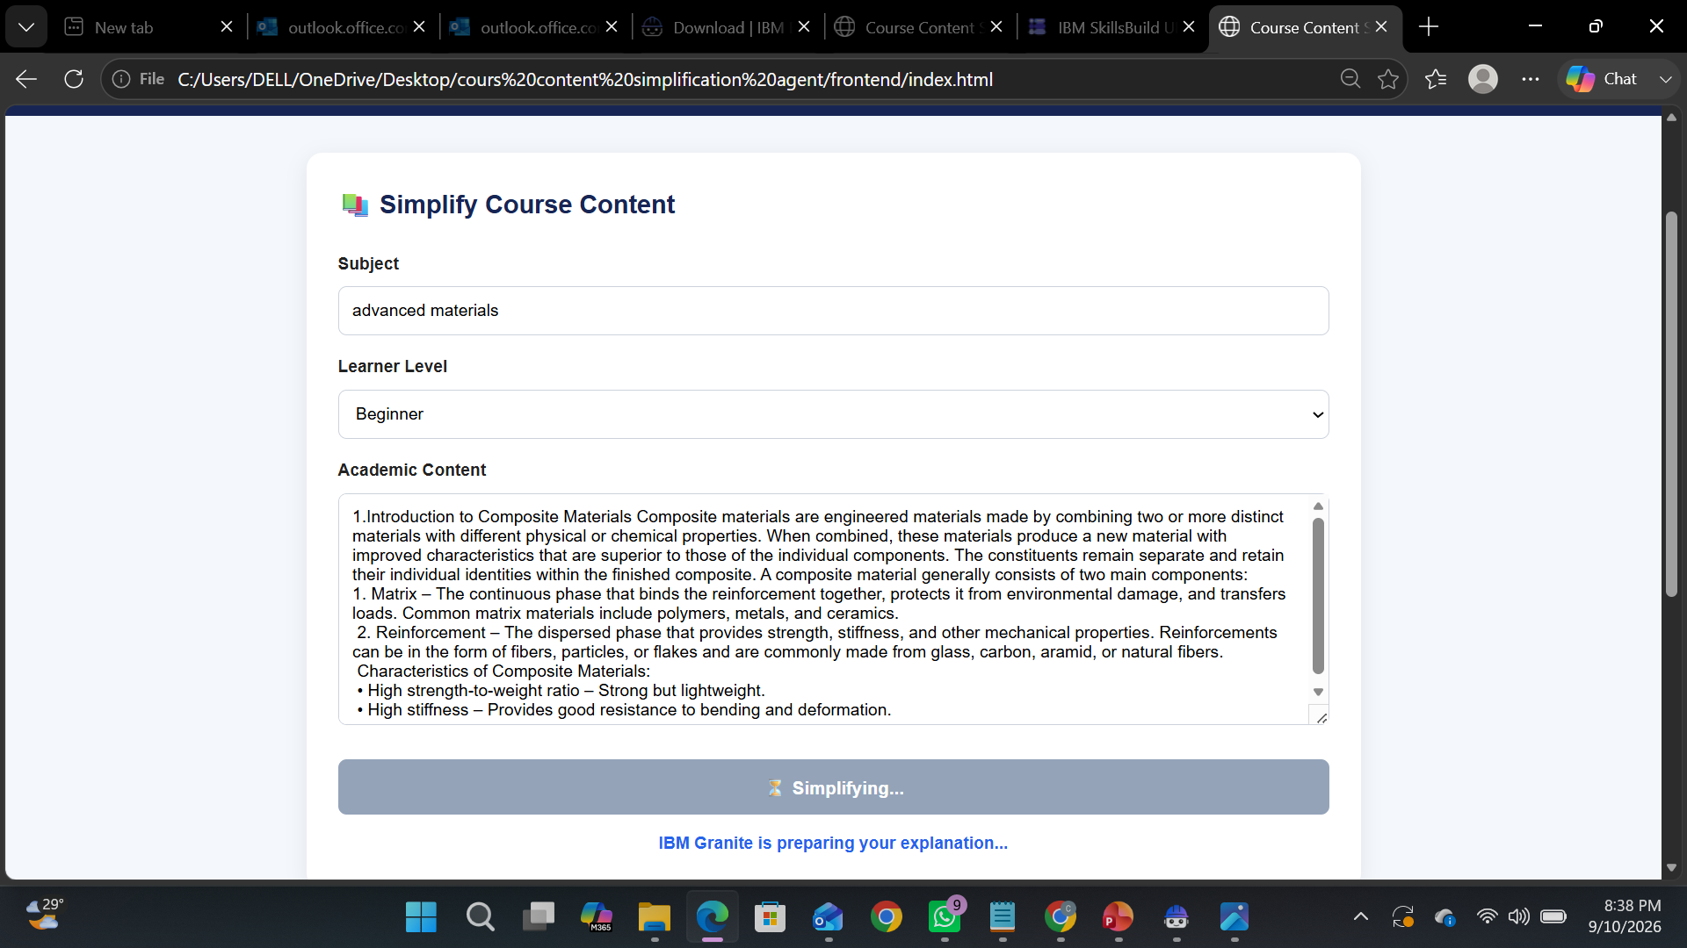
Project Output Screenshot
Please put IBM Bob output screenshots with 2-3 prompts.
You can take 2-3 more slides for each screenshot
·
·
·

Slide 14
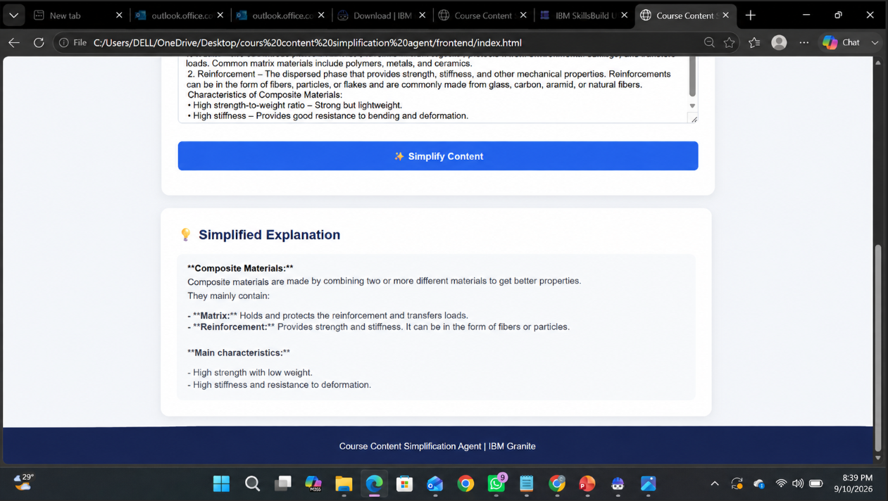
Project Output Screenshot
Please put IBM Bob output screenshots with 2-3 prompts.
You can take 2-3 more slides for each screenshot
·
·
·

Slide 15
Novelty and Uniqueness
The Course Content Project, developed using IBM watsonx.ai and IBM Bob, combines AI, RAG, and personalization to create an intelligent learning system.
AI-Powered Content Generation – Automatically generates structured course content and learning materials.
RAG-Based Accuracy – Uses relevant knowledge sources to provide reliable and context-aware content.
Personalized Learning – Adapts content according to the learner’s level and requirements.
Interactive Assessments – Generates quizzes and practice questions from course topics.
Multi-Agent Approach – Different AI agents work together for content creation, assessment, and learner support.
Scalable Solution – Built with IBM watsonx.ai and IBM Granite models for an enterprise-ready learning experience.

Slide 16
Git Hub Link
· Please create public github repository (Enable Add README button while creating repository) with format – Repository name is ibm-skillsbuild
Please test and Paste the working Github URL – https://github.com/chandanaN18/ibm-skillsbuild
Make sure you have Uploaded following three files into your github repository
1) All Agent relevant files of IBM Cloud , 2) yourproblemstatement.pdf file 3) your projectpresntation.pptx file 4)any other files
·
·
·

Slide 17
Future Scope
Advanced Personalization – Provide learning paths based on each student’s performance and interests.
Voice & Multilingual Support – Generate course content in different languages and through voice interaction.
AI Tutor Integration – Provide 24/7 AI-based doubt solving and guidance.
Automated Assessments – Generate and evaluate quizzes, assignments, and exams automatically.
Real-Time Analytics – Track student progress and identify learning gaps.
Integration with LMS – Connect with platforms like Moodle, Canvas, or other learning management systems.
Continuous AI Improvement – Improve content quality using user feedback and updated knowledge sources.
·
·
·

Slide 18
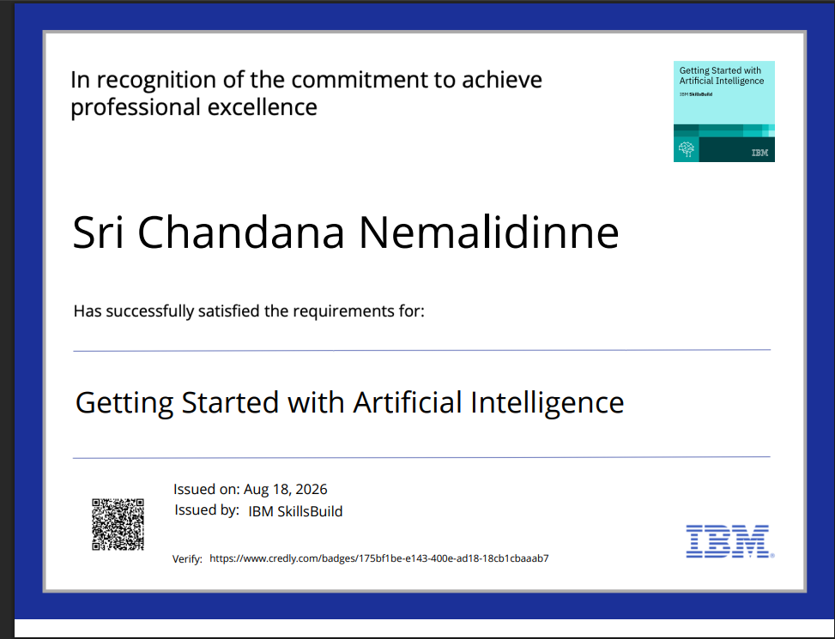
Certificates Earned:
Please add your credly certificate(Getting Started with Artificial Intelligence)

Slide 19
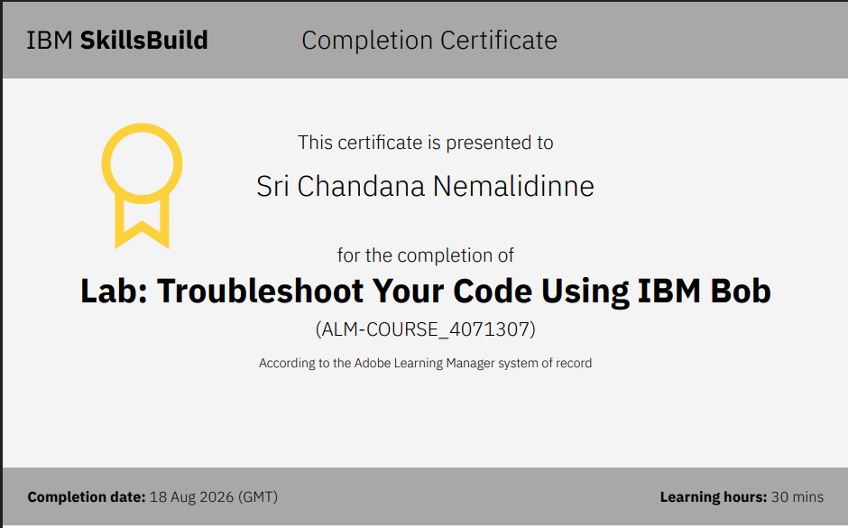
Certificates Earned:​
Add your IBM BOB Certificate

Slide 20


